Slide 1

PRESENTATION ON
AUTOMATIC FLOOR CLEANER
Submitted by
Ram Sagar Chaurasiya
Parvesh Kumar Yadav
Shivam Srivastava
Vivek Mishra
Sumit Pal
Submitted to
Dr. Anil Kumar Yadav
(Dean Academics)
Project Guide
Mrs. Komal Shaonak
(Head of Department)

Slide 2
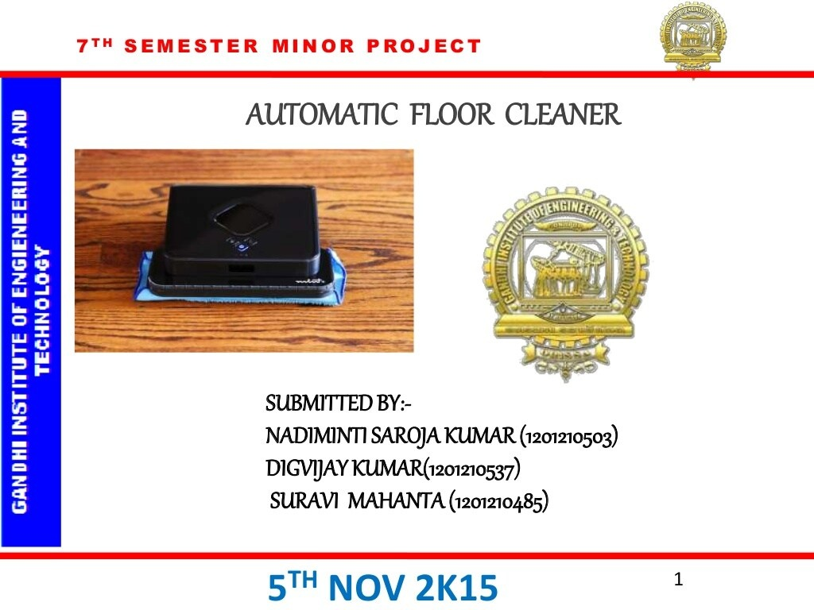
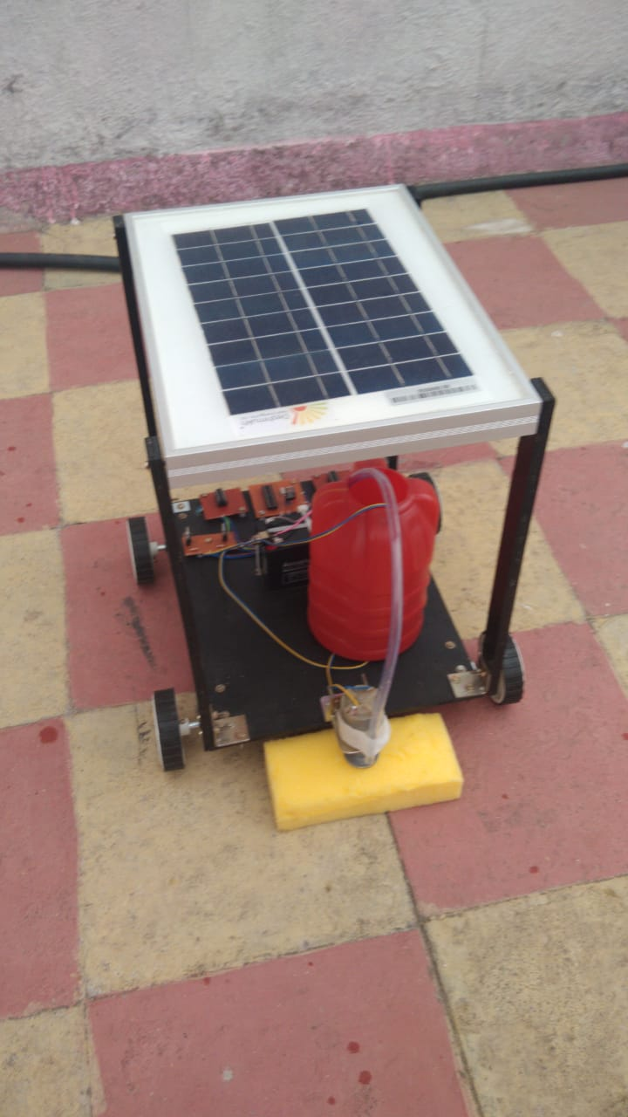

Slide 3
Objective
Objective of this project is to design the automatic floor cleaning robot in order to work human hazards place and to skip need of personnel.
To develop an autonomous robotics system using internet of things and to design a floor cleaning robot without human to the driving.
To design and implement a vacuum robot prototype by using Arduino Nano, motor driver Ultrasonic Sensor and to achieve the goal of this project

Slide 4
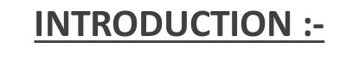
Cleaning is Important work approximate every place.
Sometimes this is easy and sometimes difficult.
In advancement of science a robot come in light but it operate by a personnel.
Households of today are becoming smarter and also more automated.

Slide 5
Scope Of Project
The scope of this project is to develop an automatic device that can derived from control room by internet of thing that work of sweeping floor without need of personnel and we need to just click a start button of the robot in smartphone application.
This project has a scope in the areas like a large floor area, human hazards area in industries like nuclear plant chemical plant and the areas where threat of dangerous gasses presence.

Slide 6
Working
The working principle of solar floor cleaning is, it has panels mounted in a particular arrangement at an in such a way that it can receive solar radiation with high intensity easily from the sun.
These solar panels convert solar energy into electrical energy. This electrical energy is stored in batteries by using a solar charger.
The motor is connected to the batteries through connecting wires. Between these two mechanical circuit breaker switches is provided. It starts and stops the working of the motor.
From this motor, the power transmits to the mechanism and this makes the moff to slide on the fixed blade and this makes to clean the floor.

Slide 7
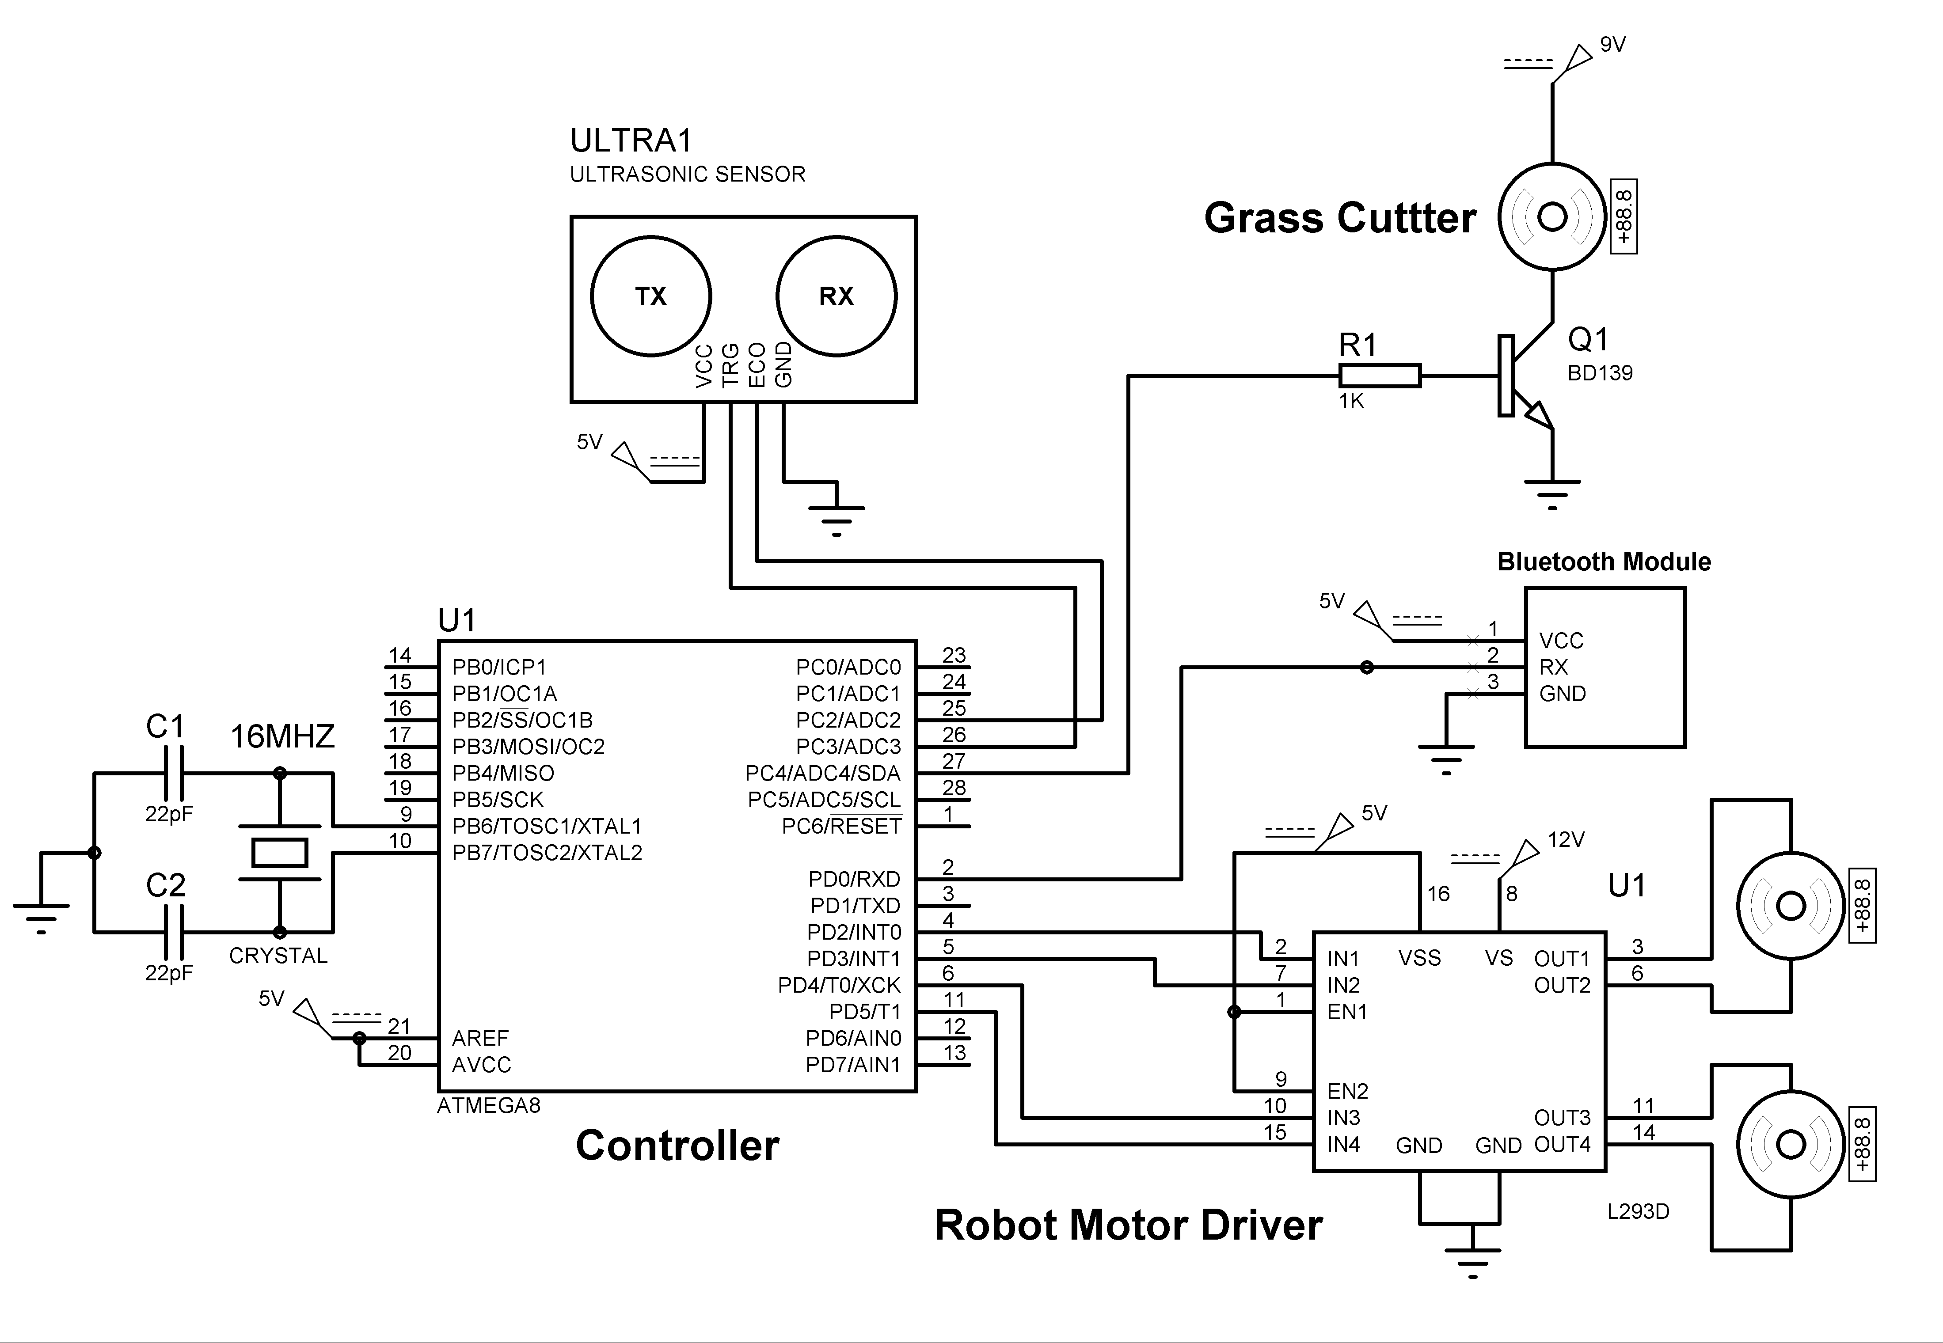
Circuit Diagram

Slide 8
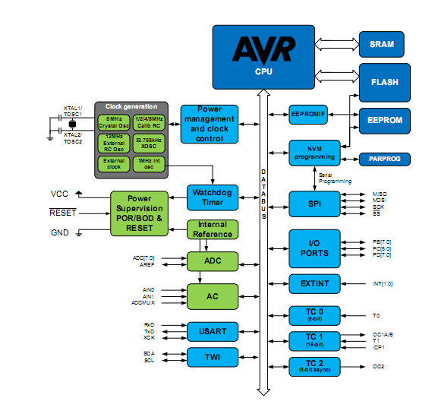
Block Diagram

Slide 9
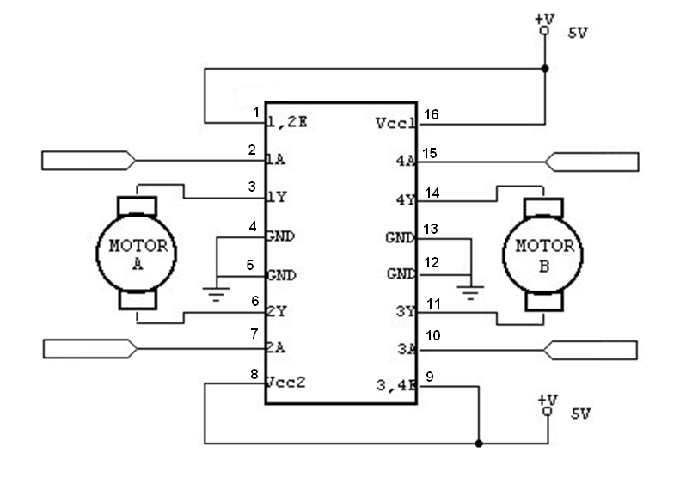
Diagram of IC-L293D

Slide 10
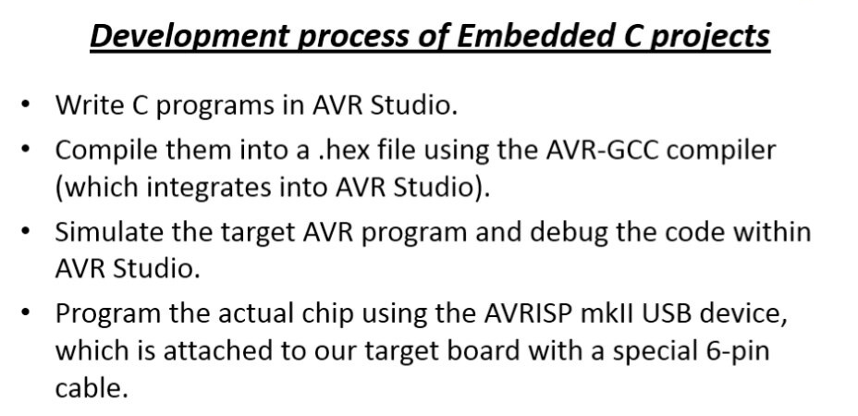

Slide 11
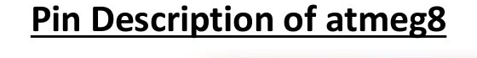
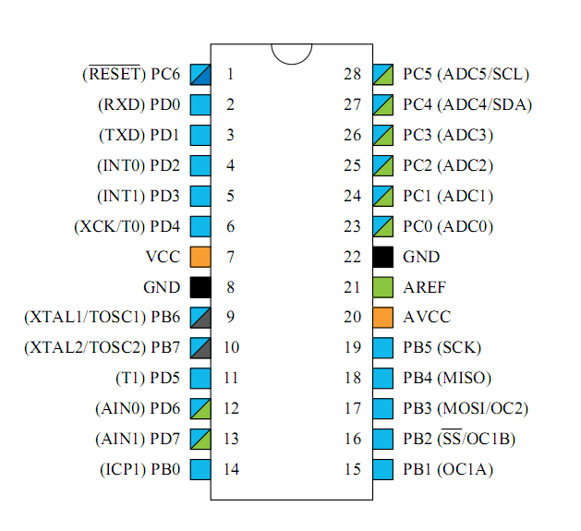

Slide 12
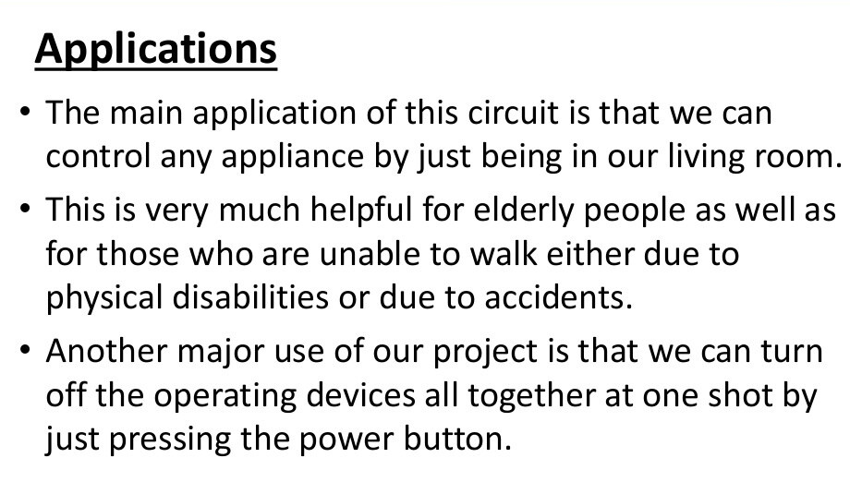

Slide 13
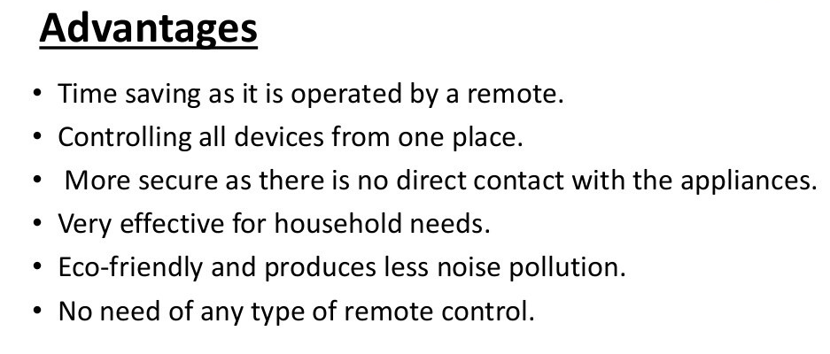

Slide 14
CONCLUSION
We have successfully completed the autonomous BLUETOOTH based floor cleaning robot model prototype and this project presents the implementation of an Automatic cleaning System controlled by Internet of Thing, but the speed of the vehicle can be reduced automatically due to the sensing of the obstacles. It reduces the accident levels and tends to save the lives of so many people. By doing this project practically we gained the knowledge about working of automatic braking system and with this future study and research.

Slide 15


Slide 16
REFERENCE
Youngkak Ma, seungwoo Kim, Dongik Oh and Youngwan Cho, "A study on the development of home mess- cleanup robot McBot", IEEE/ASME international conference on advanced mechatronics, July 2-5, 2008, Xian, China.
B.N.Prashanth, V.Karthik, S.Karthikeyan, P.Raviteja, “Design and evelopment of Drainage”.
J. Palacin, J.A. Salse, I. Valganon, and X. Clua "Building a mobile robot for a floor cleaning operation in domestic environments", Proceedings of the 20th IEEE Instrumentation Technology Conference, May 20 to May 22, 2003, Vail, Colorado, USA.
C. Hofner and G. Schmidt "Path planning and guidance techniques for an autonomous mobile.

